Slide 1
MTE 481 FDP
Group 2
Collision Avoidance for Powered Wheelchairs

Slide 2
Needs Statement
Powered wheelchairs can improve the mobility of the physically handicapped, but alertness and control are required for safe operation. Additional assistive technology is needed in order to afford the same benefits to the more severely disabled.

Slide 3
Objectives and Constraints
Make powered wheelchairs accessible to people who would otherwise be denied due to safety concerns
Must improve the safety of powered wheelchairs, for the occupant and for nearby pedestrians
It must be possible to integrate with existing models of wheelchairs

Slide 4
Criteria
Criteria | Mechanical | Weight
 |  | Size
 |  | Durability
 | Cost | Price
 |  | Power Consumption
 | Sensing | Field of Vision
 |  | Range
 |  | Precision
 |  | Quantity of useful data
 | Processing | Required processing power

Slide 5
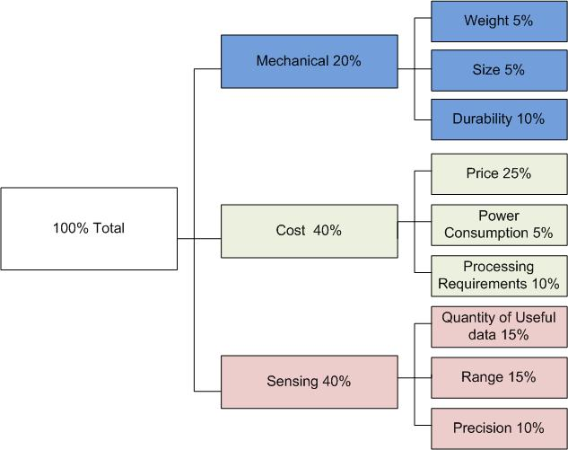
Criteria

Slide 6
Sensor Selection
 |  | Kinect |  | Lidar |  | Stereo Vision |  | Ultrasonic |  | Infrared
Criteria | Weighting | Result | Score | Result | Score | Result | Score | Result | Score | Result | Score
Weight | 0.05 | 0.2 | 0.01 | 0.2 | 0.01 | 0.2 | 0.01 | 0.1 | 0.005 | 0.1 | 0.005
Size | 0.05 | 0.25 | 0.0125 | 0.3 | 0.015 | 0.3 | 0.015 | 0.1 | 0.005 | 0.1 | 0.005
Durability | 0.1 | 0.5 | 0.05 | 0.3 | 0.03 | 0.3 | 0.03 | 0.7 | 0.07 | 0.7 | 0.07
Price | 0.25 | 0.1 | 0.025 | 1 | 0.25 | 0.5 | 0.125 | 0.03 | 0.0075 | 0.01 | 0.0025
Power Consumption | 0.05 | 0.5 | 0.025 | 0.5 | 0.025 | 0.5 | 0.025 | 0.1 | 0.005 | 0.1 | 0.005
Required Processing Power | 0.1 | 0.7 | 0.07 | 0.5 | 0.05 | 1 | 0.1 | 0.2 | 0.02 | 0.2 | 0.02
Field of Vision | 0.15 | 0.4 | 0.06 | 0 | 0 | 0.3 | 0.045 | 0.8 | 0.12 | 0.8 | 0.12
Range | 0.15 | 0.4 | 0.06 | 0.1 | 0.015 | 0.6 | 0.09 | 0.4 | 0.06 | 1 | 0.15
Precision | 0.1 | 0.5 | 0.05 | 0.1 | 0.01 | 0.5 | 0.05 | 0.75 | 0.075 | 0.75 | 0.075
Total | 1 |  | 0.3625 |  | 0.405 |  | 0.49 |  | 0.3675 |  | 0.4525

Slide 7
Prototypes
Show Rowan’s Drawings Here

Slide 8
High Level Operation
Add in good diagram

Slide 9
Testing
Show Pictures From Testing Here

Slide 10
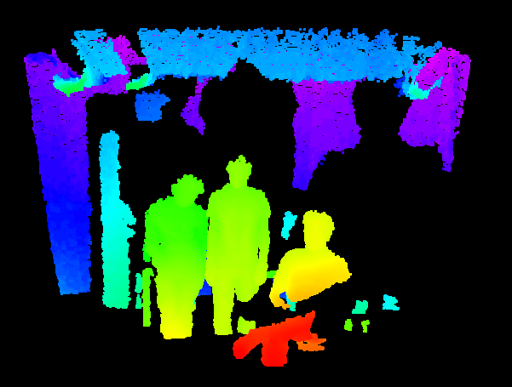
Kinect – Point Cloud

Slide 11
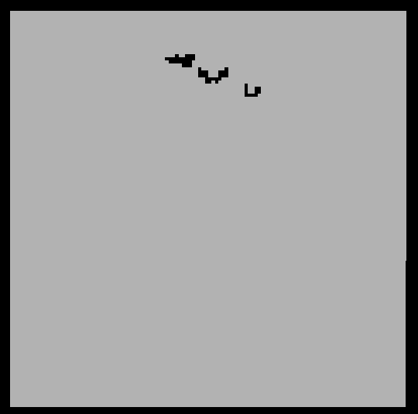
Kinect – Occupancy Map

Slide 12
Current BOM
Part | Count | Cost | Total
Xbox Kinect | 1 | 150 | 150$
Sonar Sensor | 4 | 30 | 120$
Sheet Metal (sq foot) | 4 | 3 | 12$
Spacers | 8 | 0.25 | 2$
PCB + Components | 1 | 150 | 120$
Basic Netbook | 1 | 350 | 350$
Total |  |  | 754$

